Slide 1
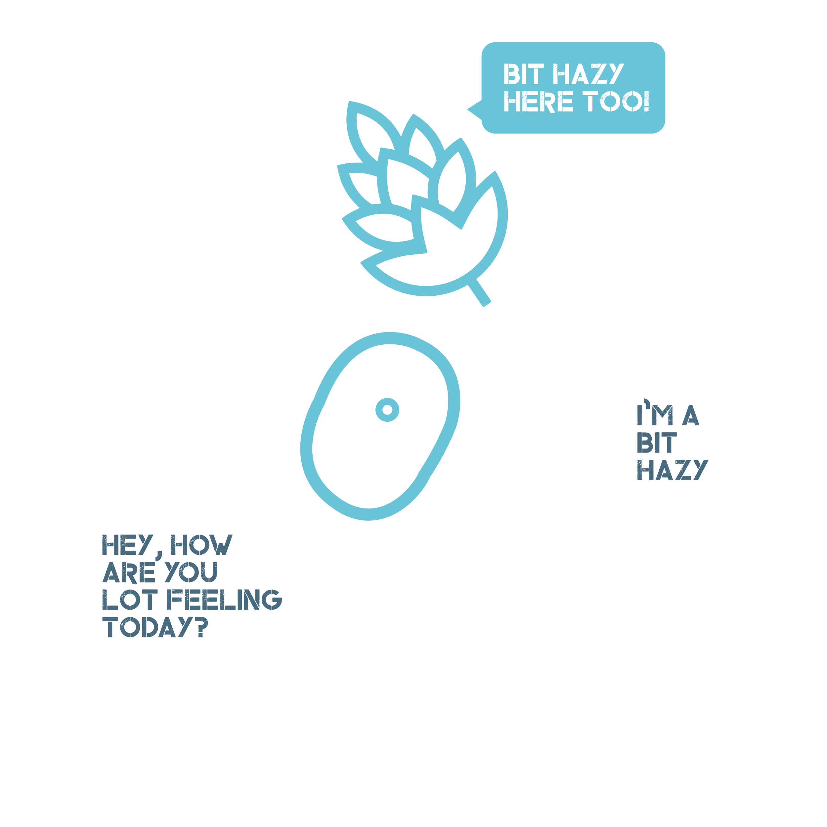

Hazy Magic: Yeast and hop selection analyzed
Dr Derek Lacey
Founder & CEO of

Slide 2
Yeast and hops analysis
Haze Background
Definition
Types in beer
Hop related haze
Experiments
Yeast and Hop dependent haze
Summary
Best yeast strains for haze beers

Slide 3


What is haze?
Suspension in the atmosphere of dry particles of dust, salt, aerosols, or photochemical smog that are so small that they cannot be felt or seen individually with the naked eye. But the aggregate reduces horizontal visibility and gives the atmosphere an opalescent
Similar to fog or smoke in the air

Slide 4

What is haze in Beer?
Haze = Turbidity
Cloudiness of a fluid caused by large particles generally invisible to the naked eye
A colloidal suspension of particles
Protein and polyphenial interaction/complex.

Slide 5
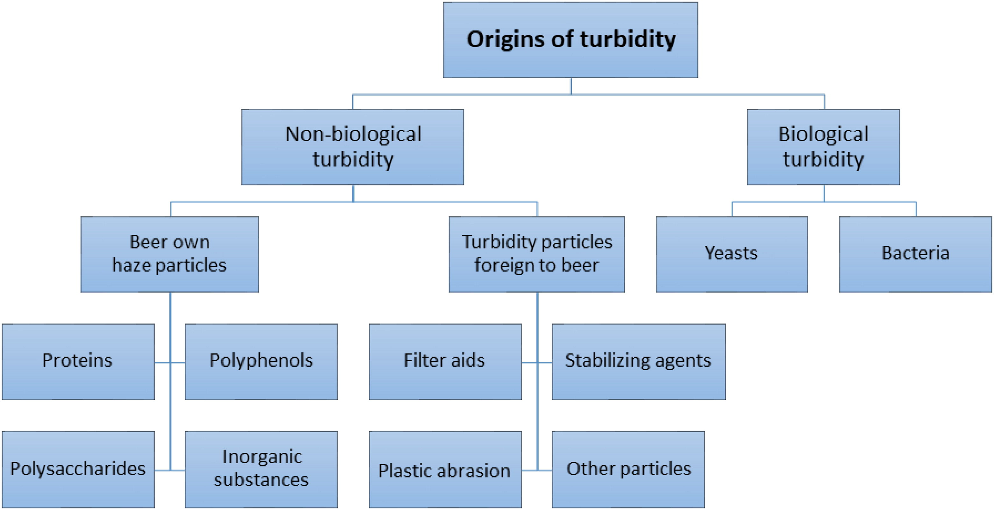
Types of haze
Kahle EM, et al ASBC 2020

Slide 6
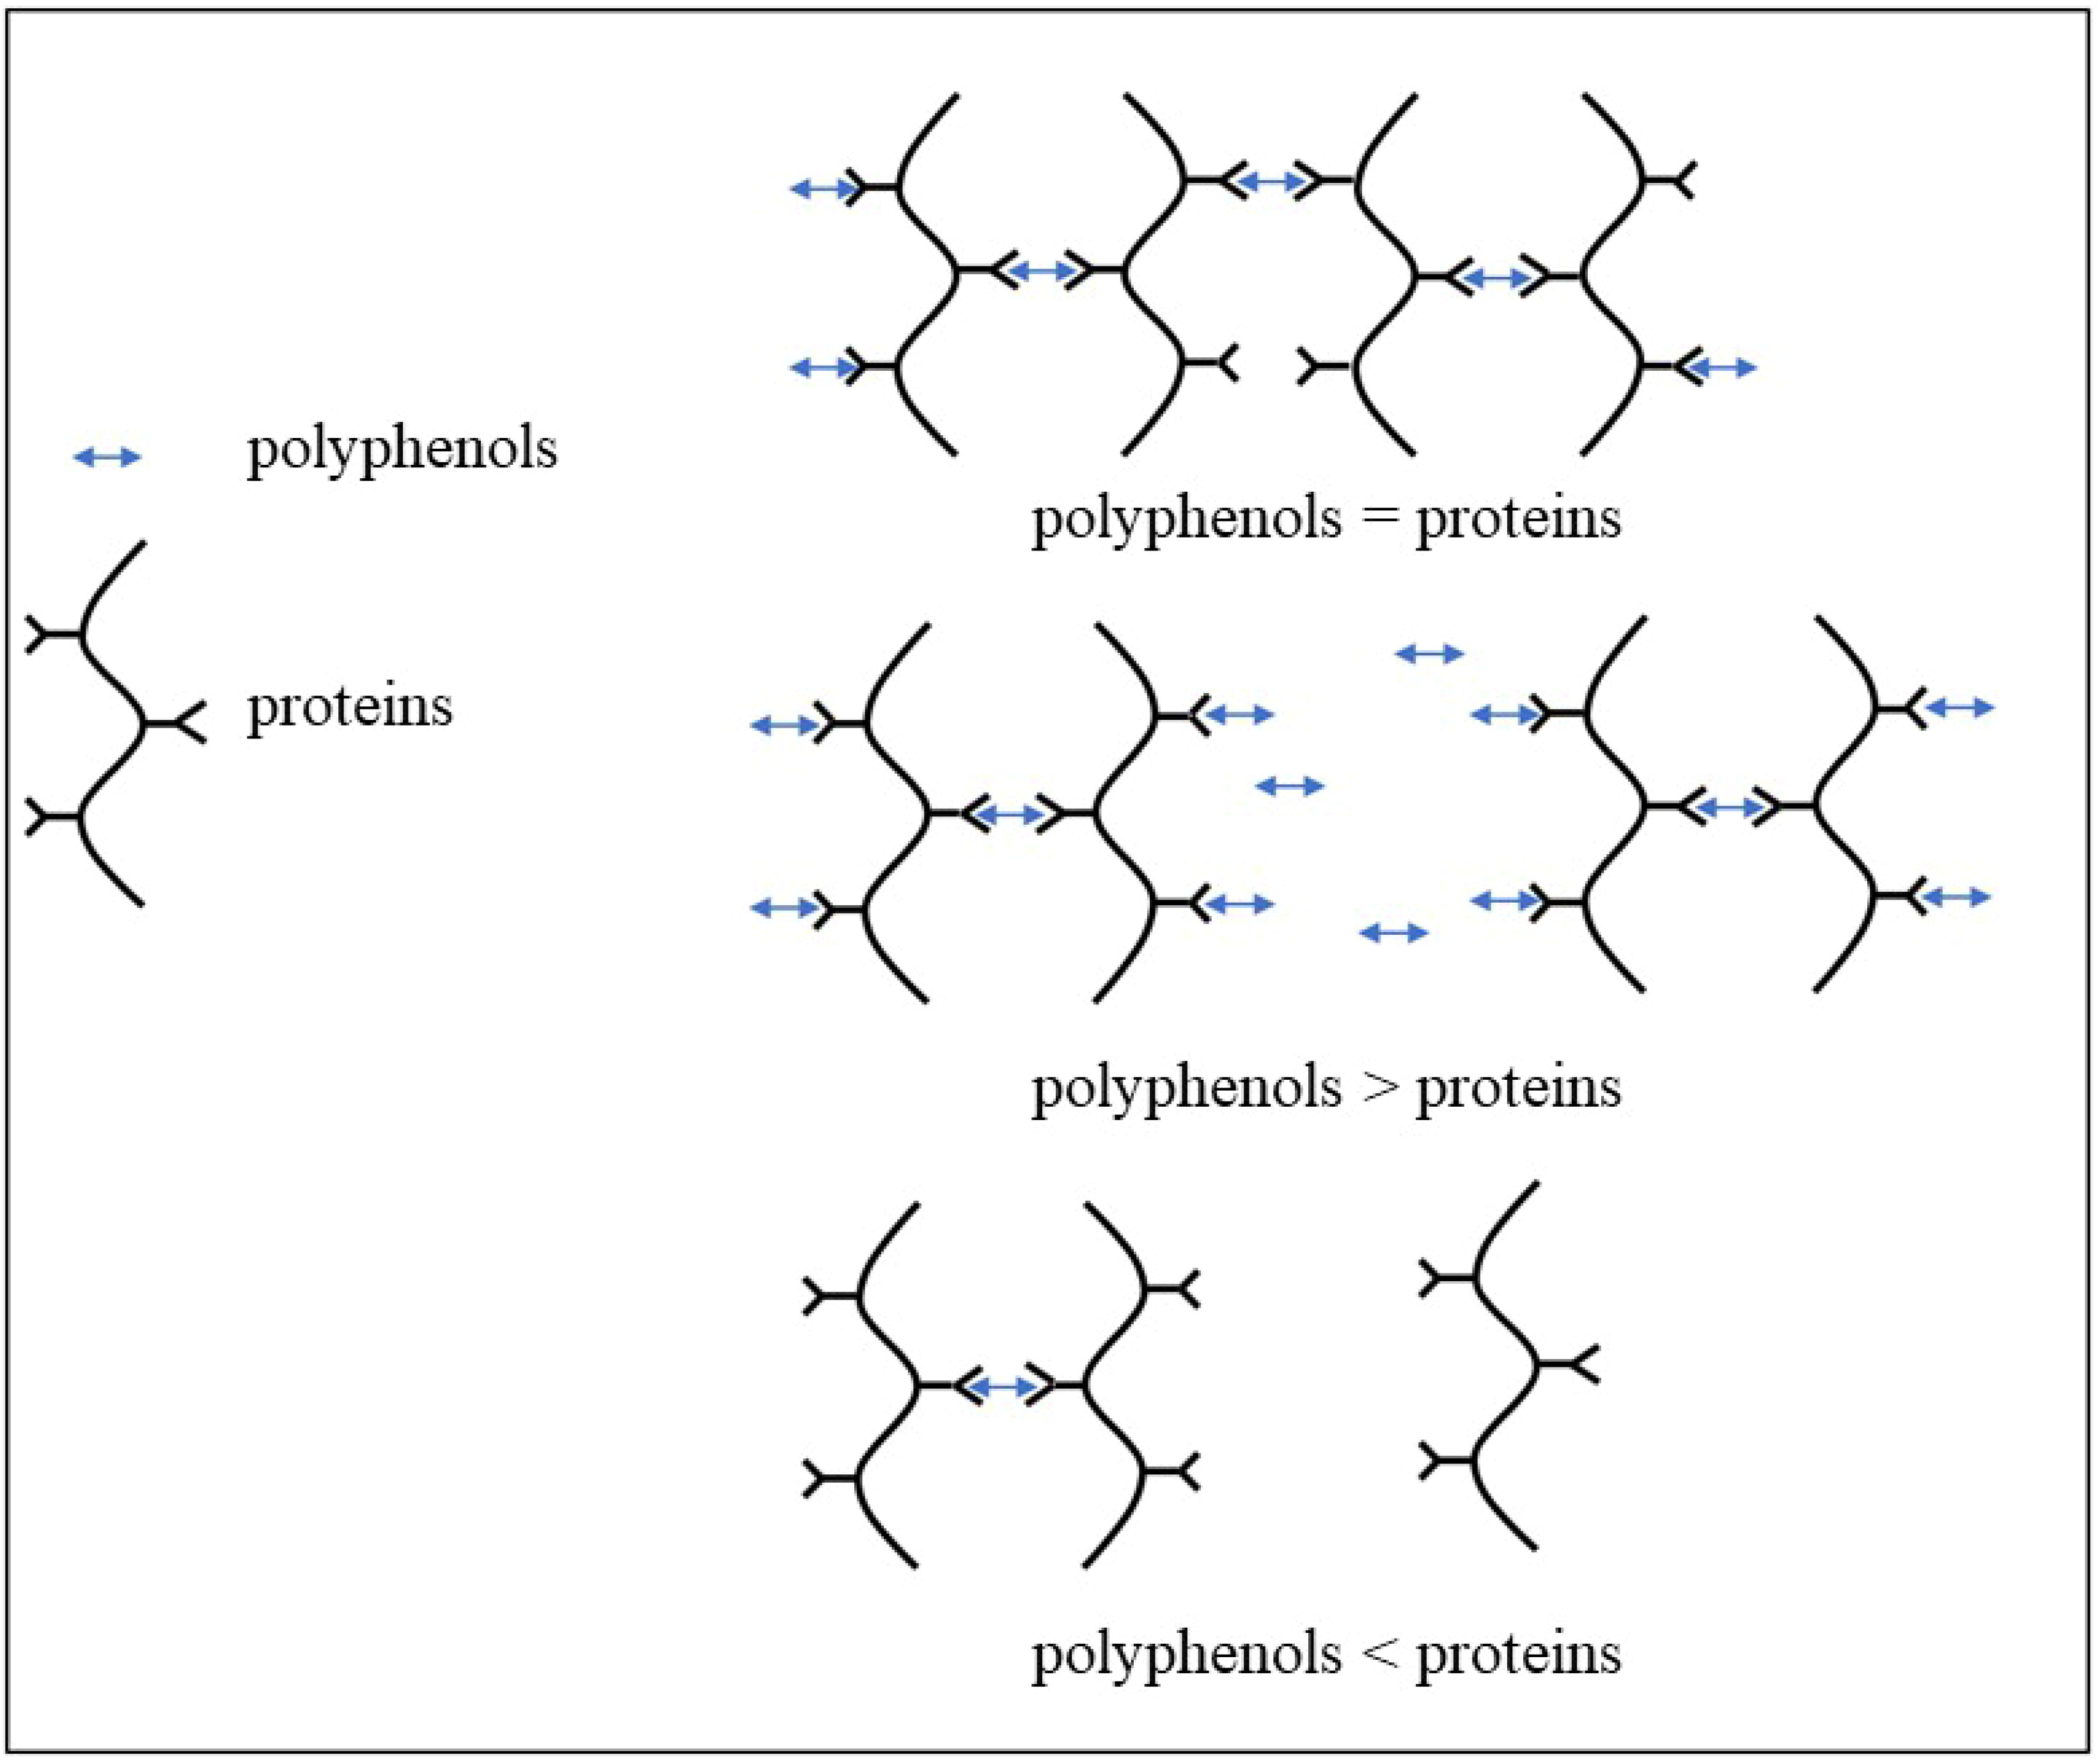
origins of haze
Proteins
Malt-derived proteins
Proline-rich (different for foam stabilizing proteins)
Barley Hordein (20)
Wheat Giladins (15% Pro% prolineline)
Haze generating smaller <40KDa proteins
Polyphenols
Proanthocyanidins
Monomers, dimers, trimers and higher polymers of catechin, epicatechin and gallocatechin
Kahle EM, et al ASBC 2020

Slide 7
How is haze measured?
Haze = Turbidity
Turbidity is measured and referred to a Nephelometric Turbidity unit
Sample | Turbidity Measurement
Water | 0.05-1.5 NTU
Lager | 5-20 NTU
Porter | 20-200 NTU
Hazy IPA | 200-1000 NTU
Orange Juice | 300-900 NTU
Milk | >4000 NTU
https://www.optek.com/en/turbidity-basics.asp

Slide 8
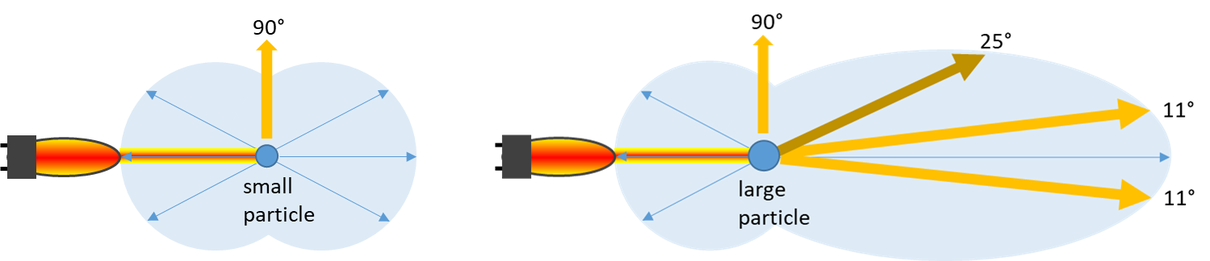
How is haze measured?
Particles in suspension will refract light at different angles depending on their size

Slide 9
Types of haze
Kahle EM, et al ASBC 2020

Slide 10
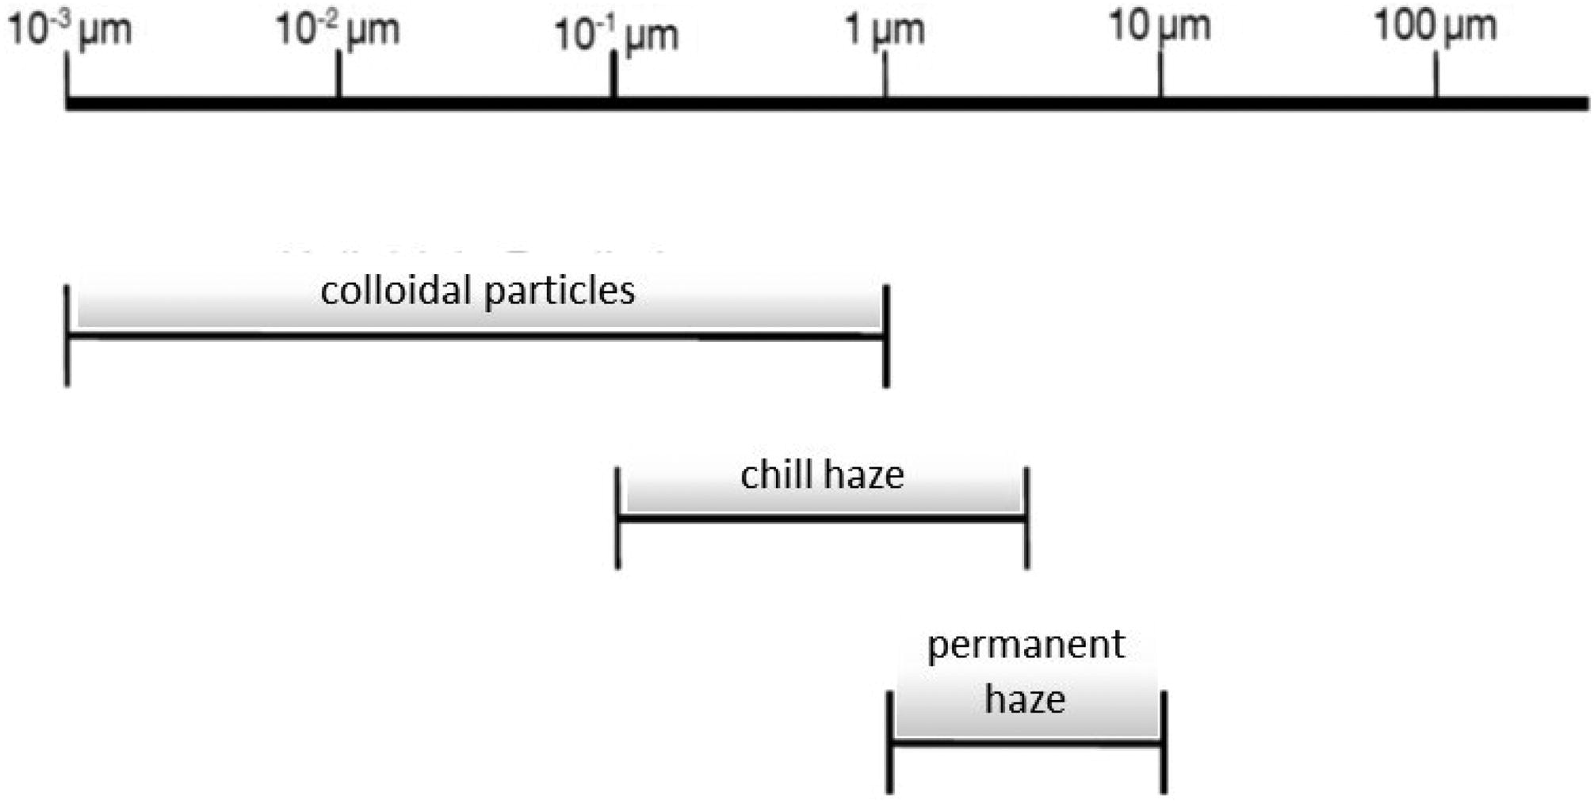
Types of haze
Chill Haze
Non-covalent interations
Hydrogen and hydrophobic bonding
Reversible
Occurs between -15-4℃ but goes away at 20℃
Permanent Haze
Covalent bonding
Often occurring with increasing age, repeated temperature change, pasteurization, oxidation
Kahle EM, et al ASBC 2020

Slide 11
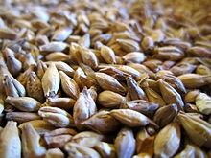
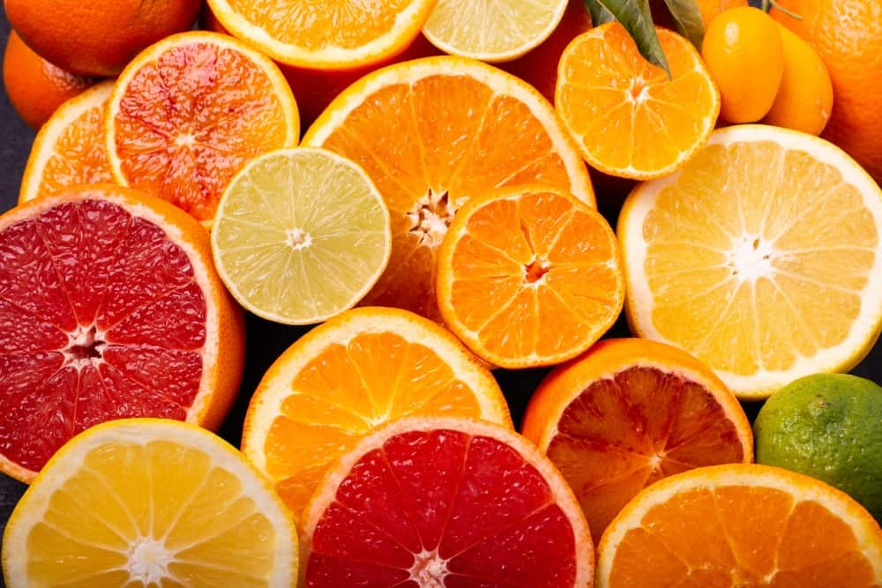
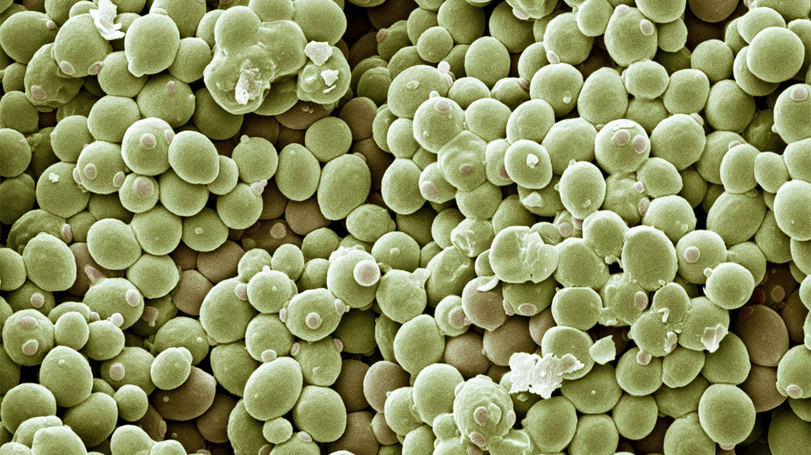
ORIGIN OF haze
Polysaccharides
Malt-derived glucans
Fruit-derived pectins
Yeast-derived glycogens, mannans, glucans

Slide 12
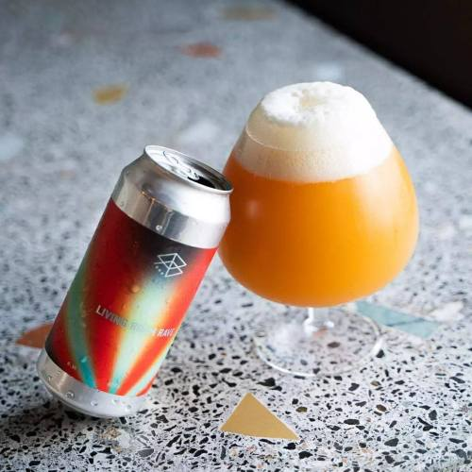
WHY DO WE WANT haze?
Haze is a carrier for hop flavor
Stabilizes the hop aroma
As haze increase, it acts as an emulsifier for nonpolar hop compounds

Slide 13
Yeast dependent haze
Yeast strain Specific haze:
Haze Positive
Haze Neutral
When to dry hop
Timing
Hop varieties/dose rate

Slide 14
Hypothesis:
Beer haze can be promoted in any beer wort and this is a yeast and hop specific phenomenon

Slide 15
Aims:
Aim 1: To identify the Haze positive strains in our bio-bank
Aim 2: To determine if different hop varieties are better at promoting haze (Galaxy, Citra and Eclipse)
Aim 3: To determine on which day to dry hop for maximum haze.

Slide 16
Materials and Methods:
Fresh Wort kit from Grain and Grape (Kolsch)
hops Galaxy, Citra and Eclipse
Yeast Pitch rate: 10 million cells/ml
Temperature: 20℃ (room temp)
Dry Hop Amount: (8g/L)

Slide 17
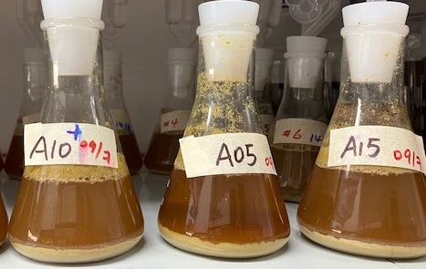
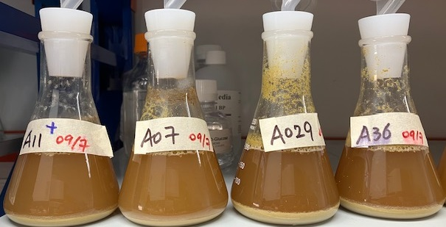
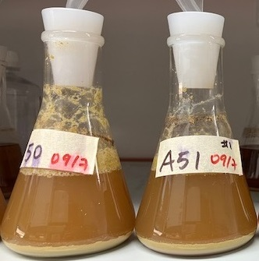
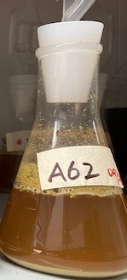
Aim 1: To test haze-positive or haze-neutral/ negative on various strains

Slide 18
Aim 1: To test haze-positive or haze-neutral/ negative strains

Slide 19
Best yeast strains for Haze
Haze Positive
Hazy IPA strains
BSY-A011 (Juice/London III/WY1318)
BSY-A036 (WY1469)
BSY-A038 (Voss Kveik)
BSY-A050 (WLP066 London Fog)
BSY-A051 (WLP008)
BSY-A062 (WLP644 “Bruxellensis” Trois)

Slide 20
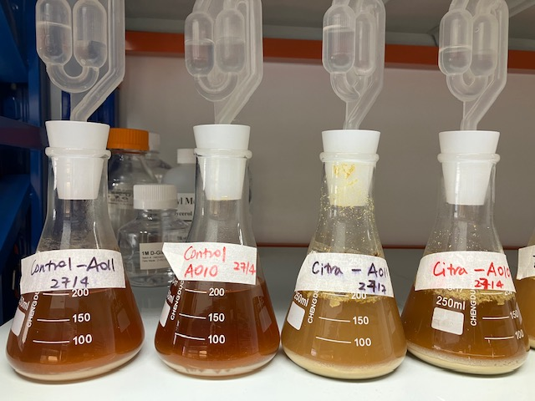
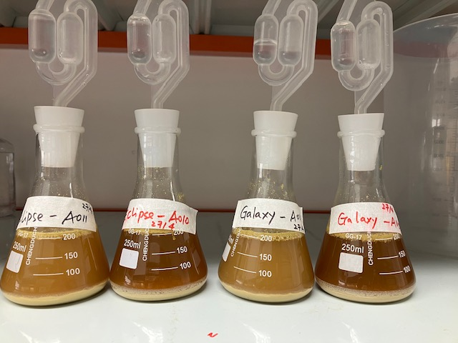
Aim 2: To determine which hop (Galaxy, Citra and Eclipse) is better at promoting haze
Control Citra Eclipse Galaxy
A011 A010 A011 A010 A011 A010 A011 A010

Slide 21
Aim 2: To determine which hop (Galaxy, Citra and Eclipse) is better at promoting haze

Slide 22
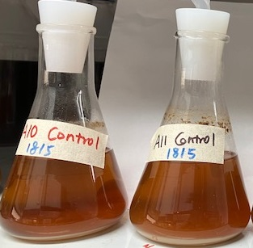
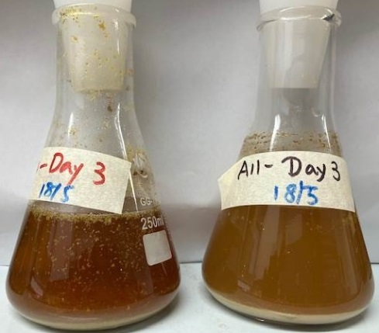
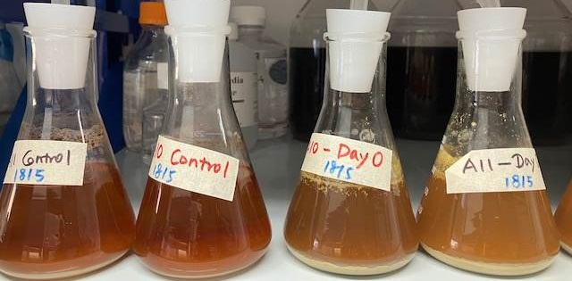
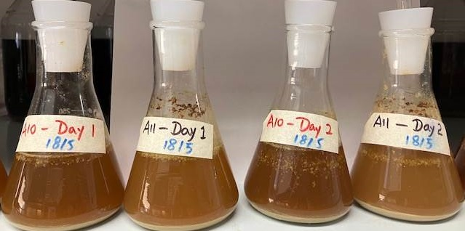
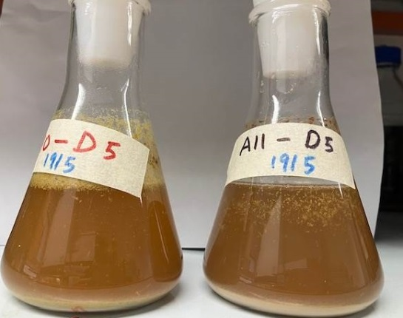
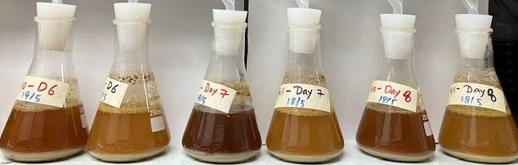
Aim 3: To determine on which day to dry hop for maximum haze.
Control Day 0 Day 1 Day 2 Day 3
A010 A011 A010 A011 A010 A011 A010 A011 A010 A011
Day 5 Day 6 Day 7 Day8
A010 A011 A010 A011 A010 A011 A010 A011

Slide 23
Aim 3: To determine on which day to dry hop for maximum haze.

Slide 24
Summary
British strains tend to promote haze
BSY-A011, BSY-A036, BSY-A038, BSY-A050, BSY-A051, BSY-A062
The 3 hops tested all promote haze with Galaxy giving the most haze in our experiments
Day 7 dry hop gave the highest level of haze in our experiments

Slide 25
Caveats and issues with experiments
Wort use not designed for hazy beer
Hops in the boil not controlled
Temperature was not controlled
The 3 hops experiment should have been a time course as this might have changed depending on timing
Other hop varieties should have been test as these hops are popular in hazy beers
Double dry hopping not completed

Slide 26
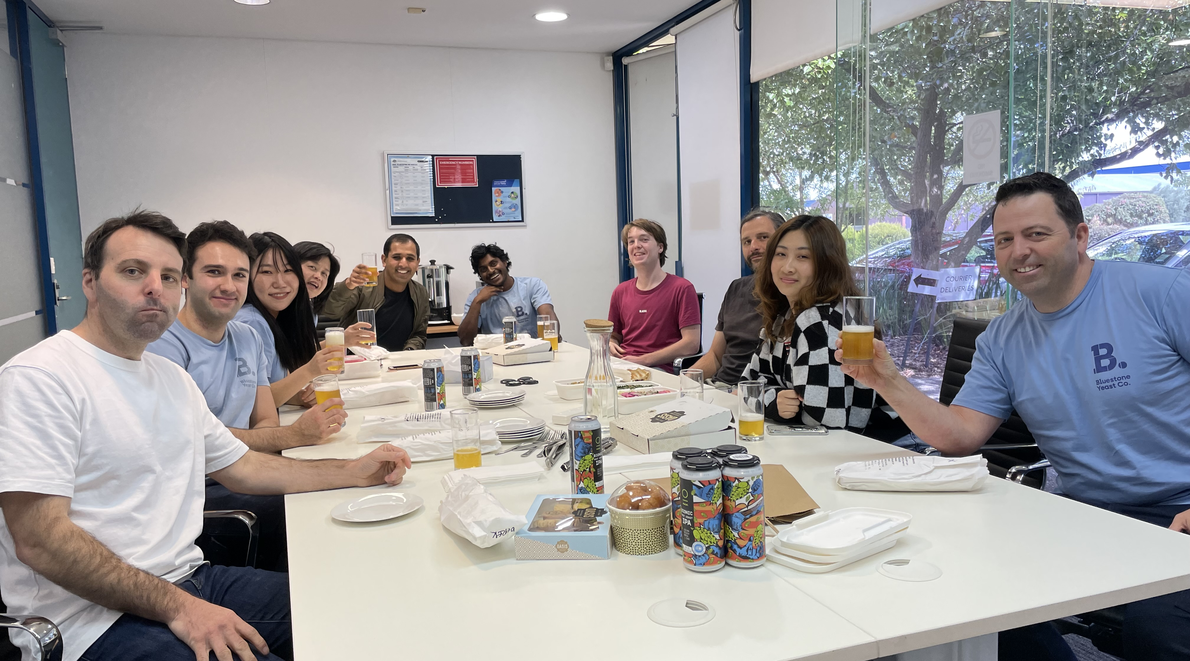
Acknowledgements

Slide 27
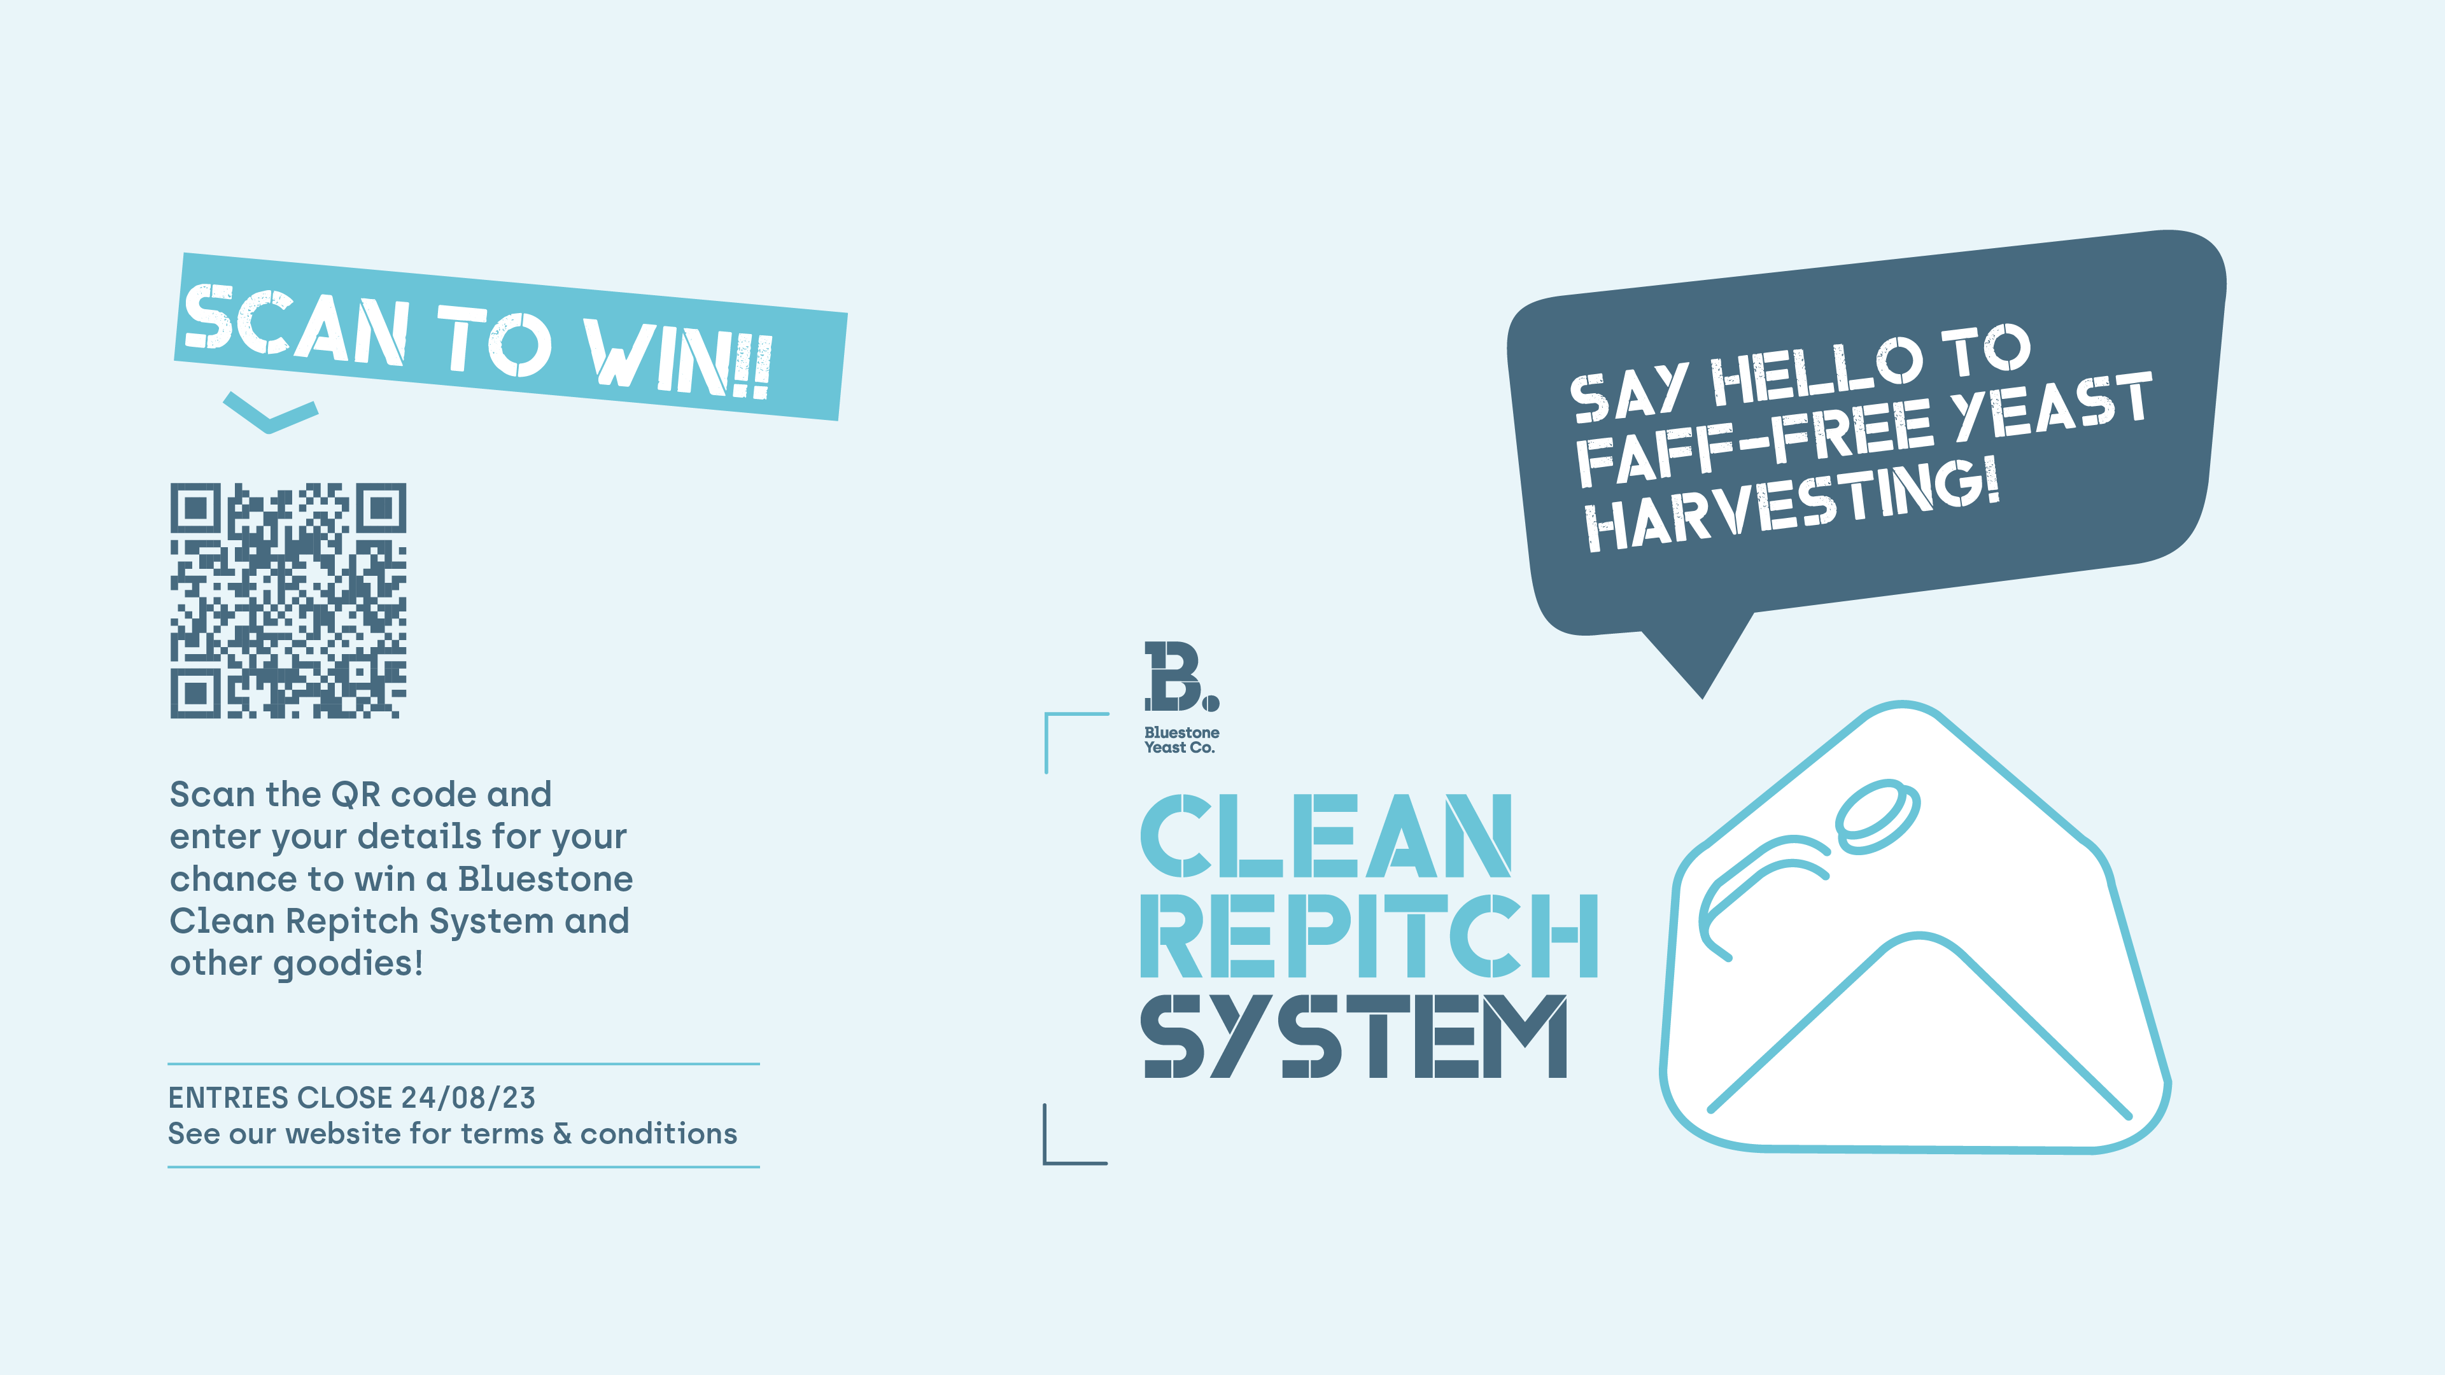

Slide 28


Slide 29

Thanks!
//bluestoneyeast.com.au

